Slide 1



PERSONAL HEALTH CARE MANAGEMENT SYSTEM USING MACHINE LEARNING TEJA (209E1A0509) NIRANJAN (209E1A0511) POOJITHA (209E1A0544) MOUNIKA (209E1A0562) BATCH No : 04 UNDER THE ESTEEMED GUIDANCE OF Ms. I.Madhavilatha M.Tech., Assistant Professor
DEPARTMENT OF COMPUTER SCIENCE AND ENGINEERING SRI VENKATESWARA ENGINEERING COLLEGE Karakambadi Road, Opp. LIC Training Center, Tirupati-517507

Slide 2
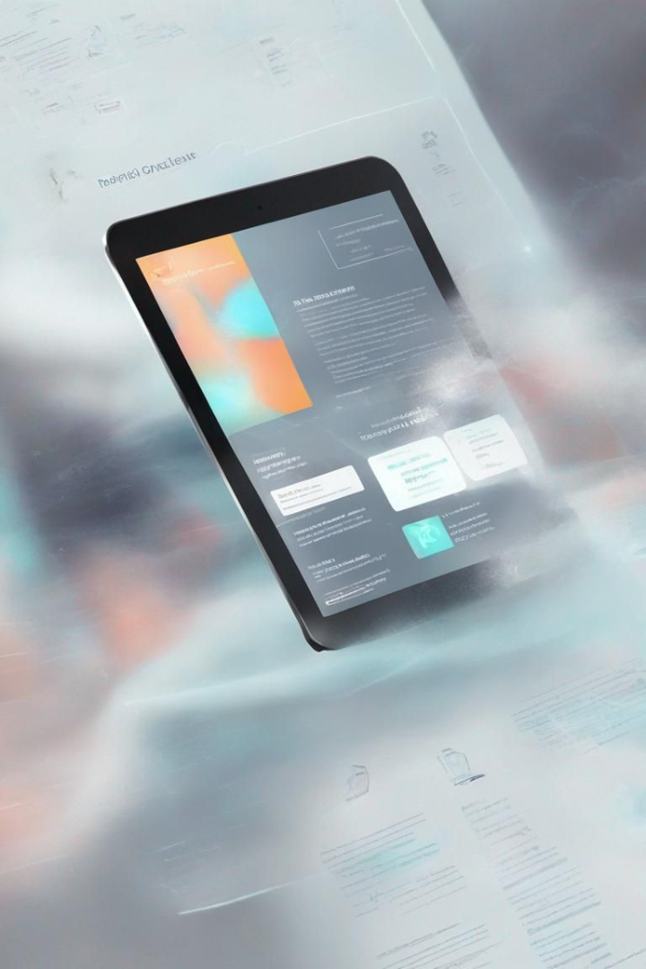
PERSONAL HEALTH CARE MANAGEMENT SYSTEM USING MACHINE LEARNING
A fusion of Machine Learning and health care spawns a revolutionary approach to personal health management. With a system designed to personalize health scores and provide actionable insights, we harness the potential of accessible technology for a healthier future.

Slide 3
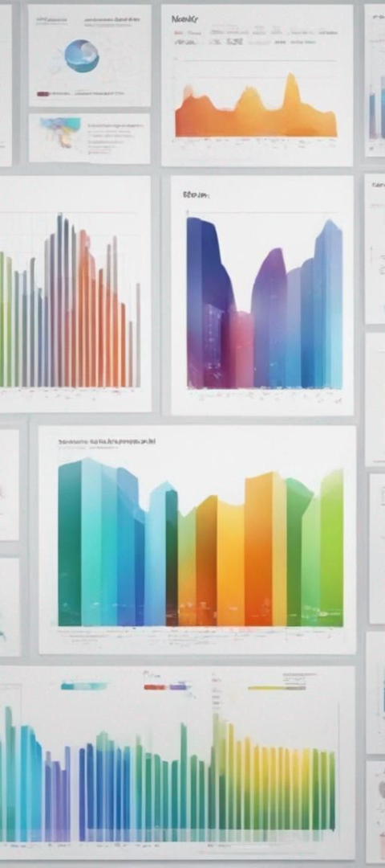
OUTLINE
Abstract
Introduction
Problem Statement
Existing Method
Proposed Method
Hardware and Software Requirements
Architecture
Merits

Slide 4
OUTLINE
UML Diagrams
Algorithms
Modules
Implementation
Conclusion
Future Enhancement

Slide 5
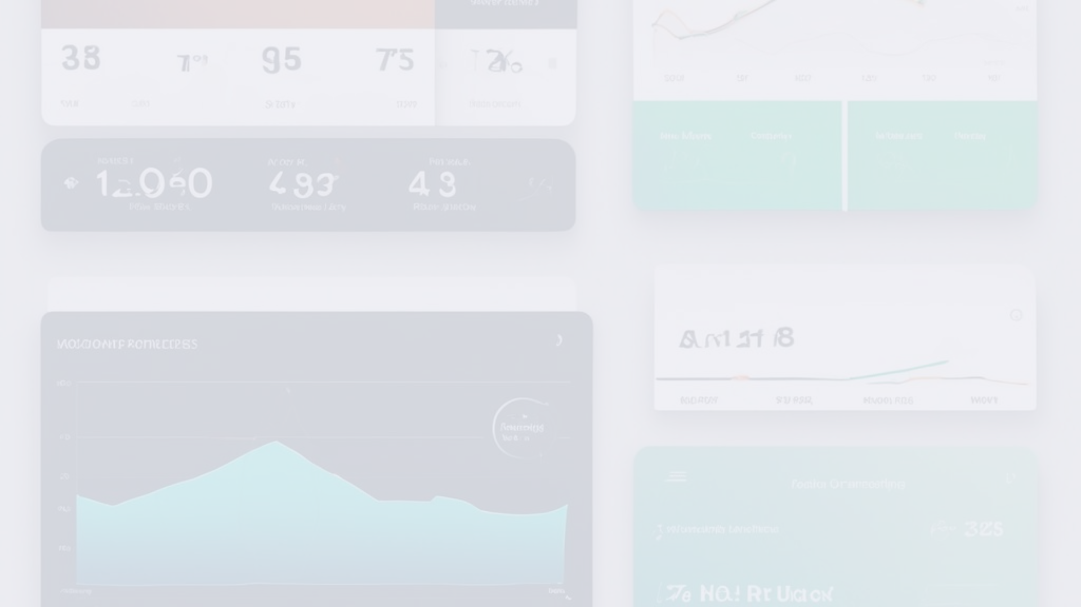
Abstract
With health increasingly sidelined in the tech era, our system emerges as a beacon of well-being, offering a seamless path to better health through everyday gadgets.
1
Accessibility
2
AI Health Scoring
3
Preventive Insights
Easy access to health management via ubiquitous devices.
Intelligent scoring system predicting health trends.
Actionable feedback to preempt health issues.

Slide 6
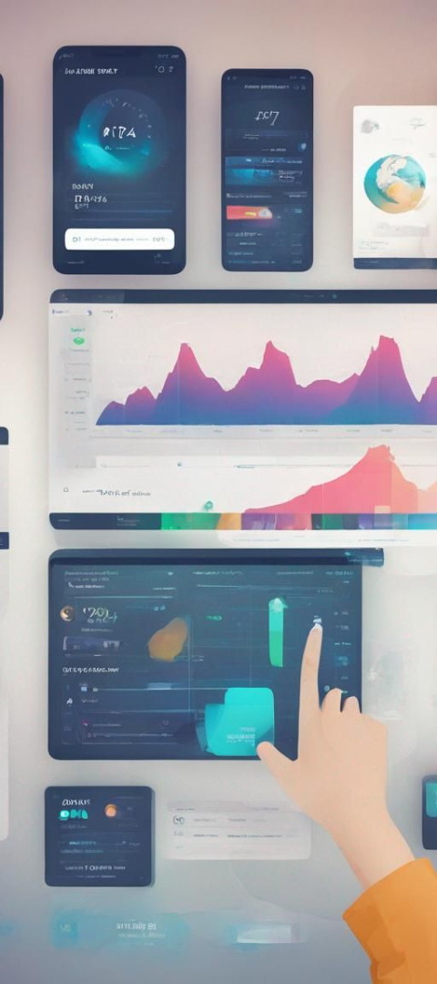
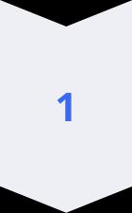
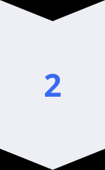
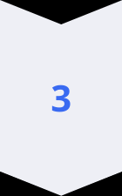
Introduction
Unveiling an ML-driven platform to empower individuals with proactive health management and timely medical intervention capabilities.
Data Entry
A portal for daily health metrics logging.
Analytic Insight
Invaluable health insights through ML analysis.
Timely Intervention
Enhanced decision-making to consult healthcare professionals efficiently.

Slide 7
Problem Statement:
The problem statement for our project is to develop a Personal Health Care Management System that utilizes machine learning techniques to provide personalized health insights and recommendations based on user metrics such as heart rate, BMI, sleep patterns, and demographic factors.

Slide 8
Existing System:
Traditional health monitoring methods come with various challenges that underscore the necessity for an evolved system.
1
1K+
Yearly Checkups
Rising Costs
Incremental medical expenses over time.

Slide 9
Proposed System:
The proposed health management system is at the vanguard of marrying cost-efficiency with daily health vigilance powered by machine learning.
Consistent Tracking
Abnormality Alerts
Cost Savings
Real-time health score updates facilitate prompt awareness.
Immediate notifications to detect any health discrepancies.
An economical alternative to conventional health assessment.

Slide 10
Hardware Requirements Specification
Specifying the technical prerequisites to foster the system's operation on a wide array of devices and software environments.
Processor
I3 (min)
RAM
4GB (min)
Hard Disk
60GB
OS
Windows
Software Tools
Jupyter, VSCode

Slide 11
Software Requirements Specification
Specifying the technical prerequisites to foster the system's operation on a wide array of devices and software environments.
Operating System
Ubuntu / Windows / Mac
Programming Languages
Python
Libraries
Pandas, numpy, Tensorflow, Django
IDE/Workbench
VScode
Technology, Database
Python 3.6+, MYSQL

Slide 12
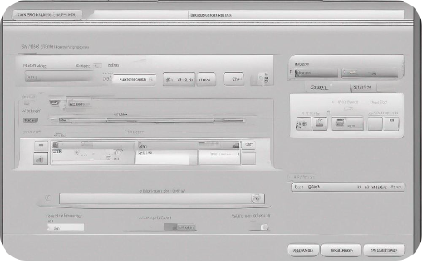


Architecture
Peering into the architectural blueprint, the system unifies user health inputs with a robust ML algorithm to dispense personalized health statuses.
User Data Collection
ML Analysis
Health Scoring
Inputs like BMI, height, and more are easily collected.
Real-time health metric analysis using ML algorithms.
A visual, intuitive star rating representing health.

Slide 13
Merits:
Personalized health insights for informed decision-making.
Timely identification of potential health issues.
Efficient utilization of machine learning for accurate predictions.
Enhanced user engagement and proactive health management.
Improved health outcomes and overall well-being.

Slide 14
UML Diagram:
The goal is for UML to become a common language for creating models of object oriented computer software. In its current form UML is comprised of two major components: a meta-model and a notation. In the future, some form of method or process may also be added to; or associated with, UML.
UML stands for unified modeling language. UML is a standardized general-purpose modeling language in the field of object-oriented software engineering. The standard is managed, and was created by, the object management group.
The unified modeling language is a standard language for specifying, visualization, constructing and documenting the artifacts of software system, as well as for business modeling and other non-software systems.

Slide 15
Use Case Diagram:
A use case diagram in the unified modeling language (UML) is a type of behavioral diagram defined by and created from a use-case analysis.
Its purpose is to present a graphical overview of the functionality provided by a system in terms of actors, their goals (represented as use cases), and any dependencies between those use cases.
The main purpose of a use case diagram is to show what system functions are performed for which actor. Roles of the actors in the system can be depicted.

Slide 16
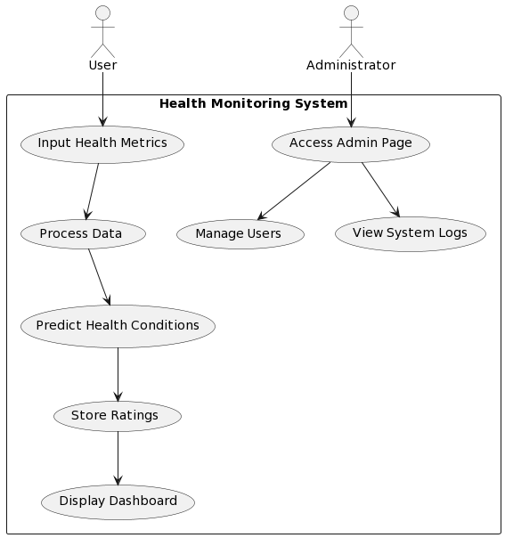

Slide 17
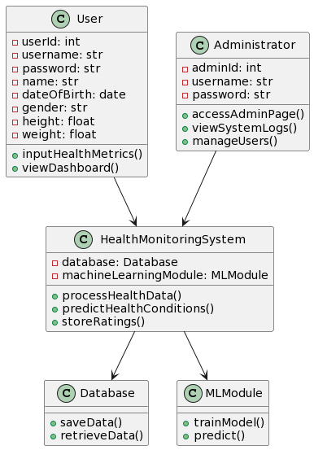
Class Diagram:
In software engineering, a class diagram in the unified modeling language (UML) is a type of static structure diagram that describes the structure of a system by showing the system's classes, their attributes, operations (or methods), and the relationships among the classes.
It explains which class contains information

Slide 18
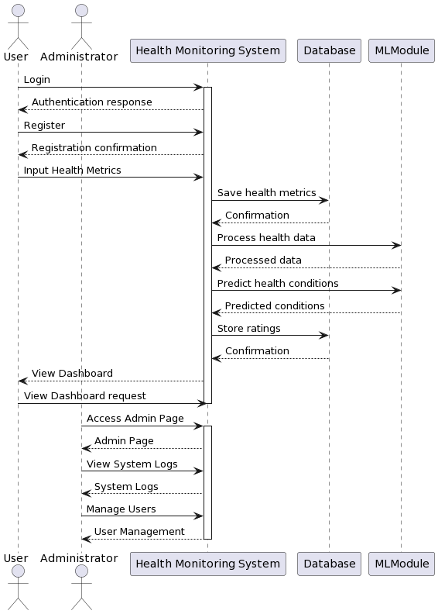
Sequence Diagram:
A sequence diagram in unified modeling language (UML) is a kind of interaction diagram that shows how processes operate with one another and in what order. It is a construct of a message sequence chart.
Sequence diagrams are sometimes called event diagrams, event scenarios, and timing diagrams.

Slide 19
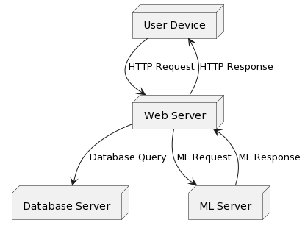
Deployment Diagram:
In software engineering, a class diagram in the unified modeling language (UML) is a type of static structure diagram that describes the structure of a system by showing the system's classes, their attributes, operations (or methods), and the relationships among the classes.
It explains which class contains information

Slide 20
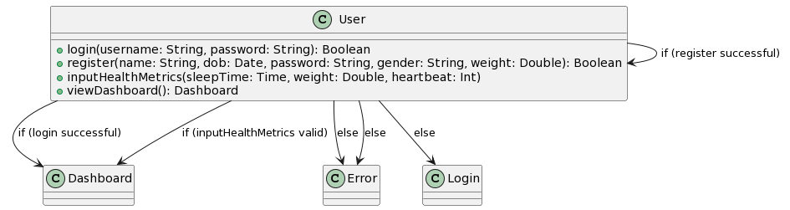
Collaboration Diagram:
In collaboration diagram the method call sequence is indicated by some numbering technique as shown below. The number indicates how the methods are called one after another. We have taken the same order management system to describe the collaboration diagram. The method calls are similar to that of a sequence diagram. But the difference is that the sequence diagram does not describe the object organization whereas the collaboration diagram shows the object organization.

Slide 21
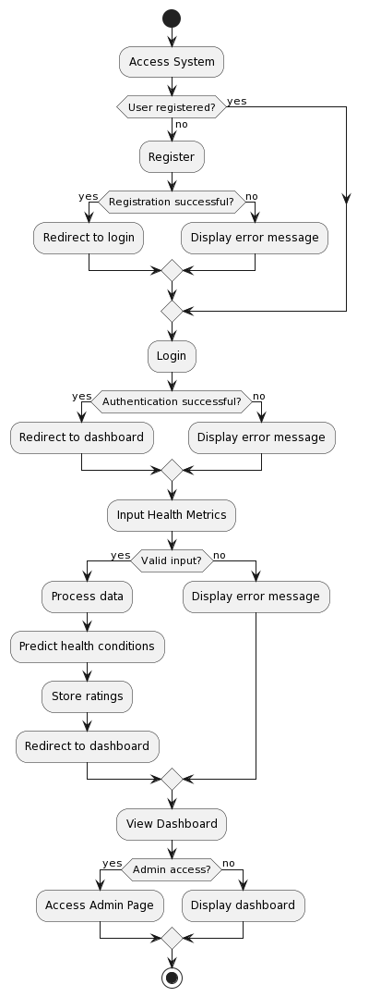
Activity Diagram:
Activity diagrams are graphical representations of workflows of stepwise activities and actions with support for choice, iteration and concurrency.
In the unified modeling language, activity diagrams can be used to describe the business and operational step-by-step workflows of components in a system.
An activity diagram shows the overall flow of control.

Slide 22
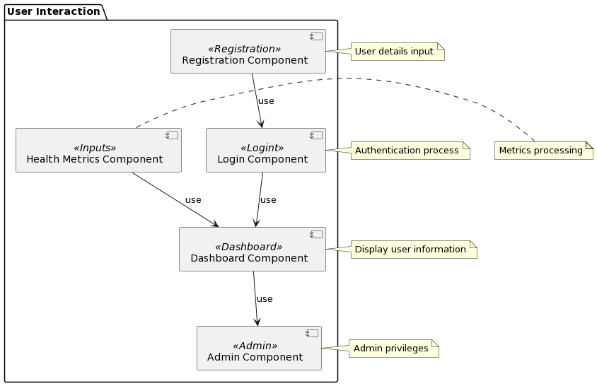
Component Diagram:
For our health monitoring platform, a component diagram describes the organization and wiring of physical components, including software modules and hardware devices. It illustrates how the system's components are structured and interconnected to fulfill the system's functionalities. By visualizing the component architecture, the diagram helps to ensure that all aspects of the system's required functions are covered and well-planned.

Slide 23
ER Diagram:
In software engineering, a class diagram in the unified modeling language (UML) is a type of static structure diagram that describes the structure of a system by showing the system's classes, their attributes, operations (or methods), and the relationships among the classes.
It explains which class contains information

Slide 24
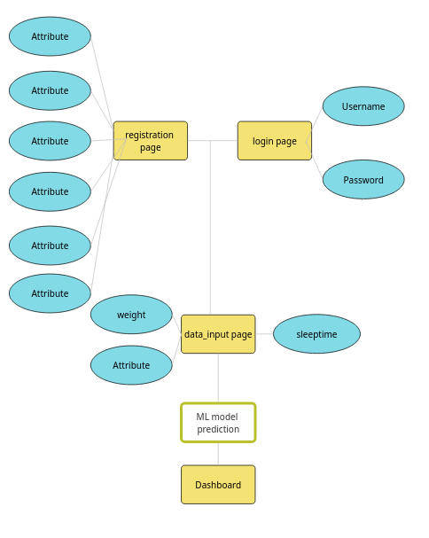

Slide 25
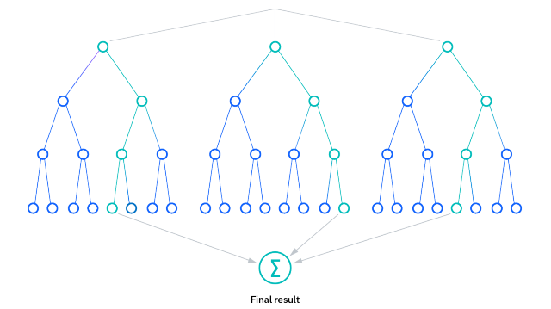
Algorithm:
Random Forest:
A random forest is a machine learning technique that’s used to solve regression and classification problems. It utilizes ensemble learning, which is a technique that combines many classifiers to provide solutions to complex problems.
A random forest algorithm consists of many decision trees. The ‘forest’ generated by the random forest algorithm is trained through bagging or bootstrap aggregating. Bagging is an ensemble meta-algorithm that improves the accuracy of machine learning algorithms.

Slide 26
Random Forest:
The (random forest) algorithm establishes the outcome based on the predictions of the decision trees. It predicts by taking the average or mean of the output from various trees. Increasing the number of trees increases the precision of the outcome.
A random forest eradicates the limitations of a decision tree algorithm. It reduces the over fitting of datasets and increases precision. It generates predictions without requiring many configurations in packages

Slide 27
Modules:
1.User Management:
Registration: Users can register for the health monitoring platform, providing necessary details.
Login: Registered users gain access to their personalized dashboard.
2.Data Handling:
Upload: Users can upload datasets, potentially sourced from platforms like Kaggle.
View Data: Before preprocessing, users can inspect the raw data for analysis.
3.Preprocessing:
Data Cleaning: Identifying and handling missing values using techniques like front fill (ffill).
Training Data Preparation: Splitting the dataset into training and testing subsets for model training and evaluation.
4.Model Prediction:
Input: Users input their health metrics for prediction.
Result History: The model predicts health conditions based on the provided inputs, offering insights into emergency cases and non-emergency cases.

Slide 28
Implementation
In our project, we start by loading the EDAdmissionDataset CSV file and checking for null values. The dataset is then split into train and test data. We apply the decision tree algorithm and achieve optimal accuracy. Leveraging the Django framework, users access Home, About, View, Model Training, and Prediction pages. Our decision tree-based Machine Learning Model detects emergency cases effectively.

Slide 29
Data Collection:
Datasets are sourced from Kaggle, encompassing diverse health-related metrics such as heart rate, BMI, sleep time, gender, and age.
Additional datasets may be combined to enrich the dataset, providing a comprehensive set of features for analysis.
Data Cleaning and Preprocessing:
Initial data exploration is conducted to identify missing values and outliers.
Missing values are addressed using techniques like front fill (ffill), ensuring data integrity.
Data is standardized and normalized to mitigate variations and ensure consistency across features.
Categorical variables encoded using techniques like one-hot encoding for compatibility with machine learning algorithms.
Feature Engineering:
Feature selection techniques are applied to identify the most relevant features for predicting health conditions.
New features may be derived from existing ones to capture additional insights, enhancing the predictive power of the model.

Slide 30
3. Model Selection:
The Random Forest algorithm is chosen for its robustness and ability to handle complex datasets with high dimensionality.
Hyperparameter tuning performed to optimize model performance, ensuring the best possible accuracy and generalization.
4. Model Training:
The dataset is split into training and testing subsets, typically using a 80-20 split.
The Random Forest model is trained on the training subset using the .fit() method, learning patterns and relationships within the data.
6. Model Evaluation:
The trained model is evaluated on the testing subset to assess its performance and generalization ability.
Metrics such as accuracy are calculated to measure the model's effectiveness in predicting health conditions.

Slide 31
7. Model Deployment:
Once the model achieves satisfactory performance, it is deployed into the production environment.
Integration with the Django framework allows seamless incorporation into the health monitoring platform, enabling real-time predictions for users.
8. Monitoring and Maintenance:
Continuous monitoring of the deployed model is essential to ensure its ongoing performance and reliability.
Regular updates and retraining may be conducted to adapt to changing data distributions and maintain model accuracy over time.

Slide 32
Conclusion
Our project marks a significant stride in personal health care management, amalgamating machine learning methodologies within the robust Django framework. Through the strategic implementation of decision tree algorithms, we have successfully crafted a system capable of precise health condition predictions based on user metrics. This empowers users with personalized health insights, facilitating informed decision-making and proactive health management. By prioritizing health concerns and offering timely interventions, our endeavor seeks to elevate overall health outcomes and augment user well-being.

Slide 33
Future Enhancement:
Future scopes for our project include:
Integration of additional health metrics for more comprehensive insights.
Implementation of real-time health monitoring using wearable devices.
Expansion to incorporate predictive analytics for early disease detection.
Collaboration with healthcare providers for seamless data sharing and monitoring.
Development of mobile applications for user-friendly access and convenience.

Slide 34

Thank you

